Slide 1
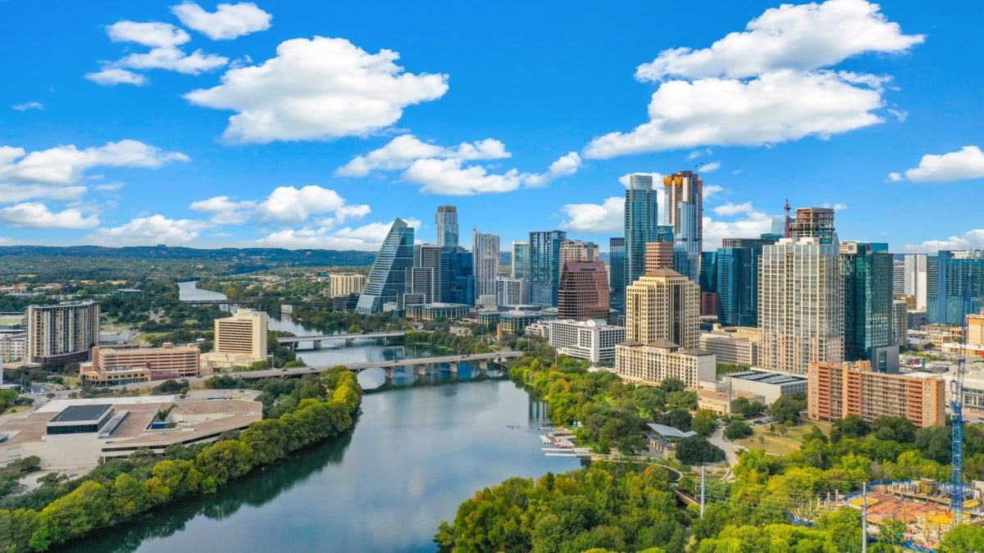
By Trevis Slagowski and Treyson Grange
AUSTIN

Slide 2

Affordable Rentals
for Average Teachers
Compared the means of Teacher Rental Affordability against crime type per Council District.
Notes:
A general overview of what we looked into for this analyses

Slide 3
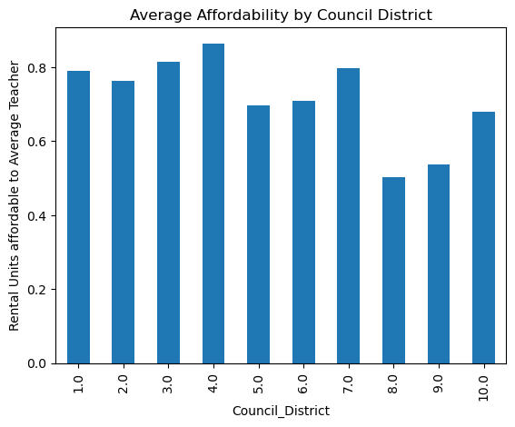
Average Affordability by Council District
The most affordable rentals where in District 4 (East District) consisting of urban neighborhoods and University.
While the least affordable where in District 8 with golf courses, malls, and suburban neighborhoods.
Notes:
A general overview of what we looked into for this analyses

Slide 4
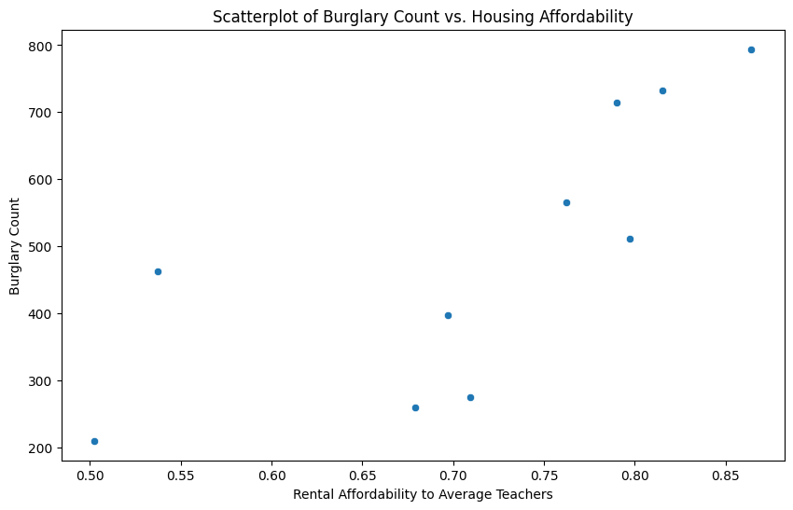
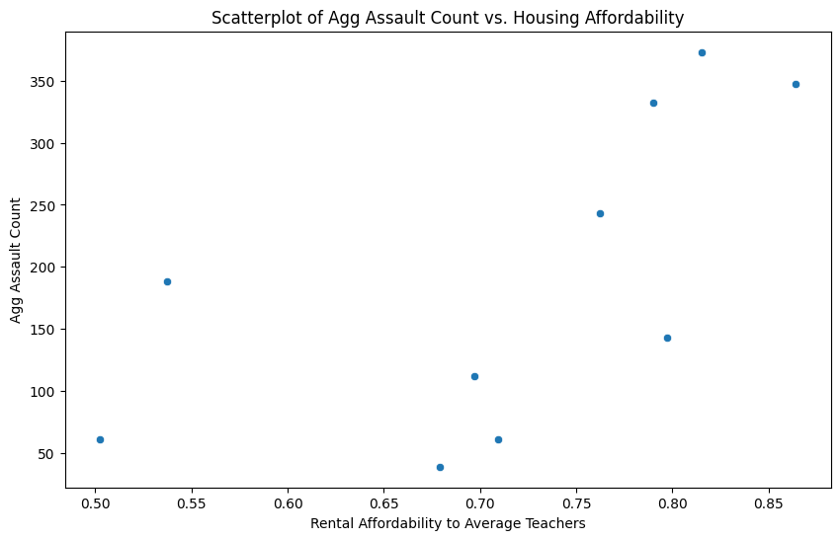
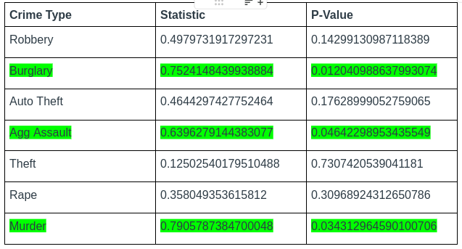
Crime Count vs Housing Affordability
Notes:
A general overview of what we looked into for this analyses

Slide 5
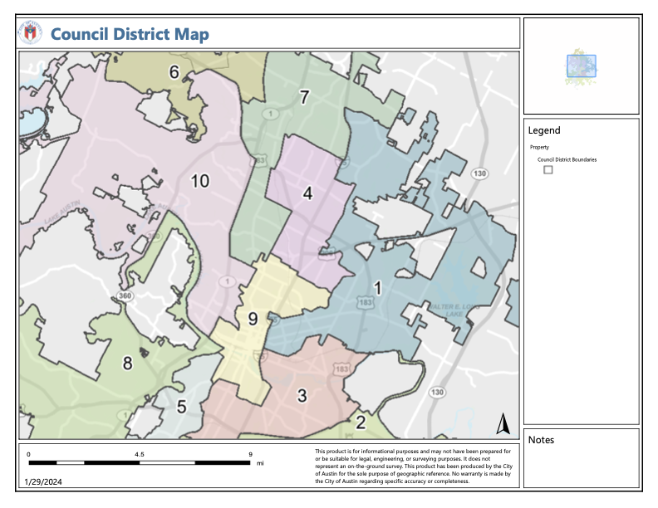
Graphic Overview
Districts 1, 3, 4, and 7 had the highest affordability and are all located close geographically (East Austin).
While Districts 8, 9 and 10 had lower affordability in Central/West Austin.
Notes:
A general overview of what we looked into for this analyses

Slide 6
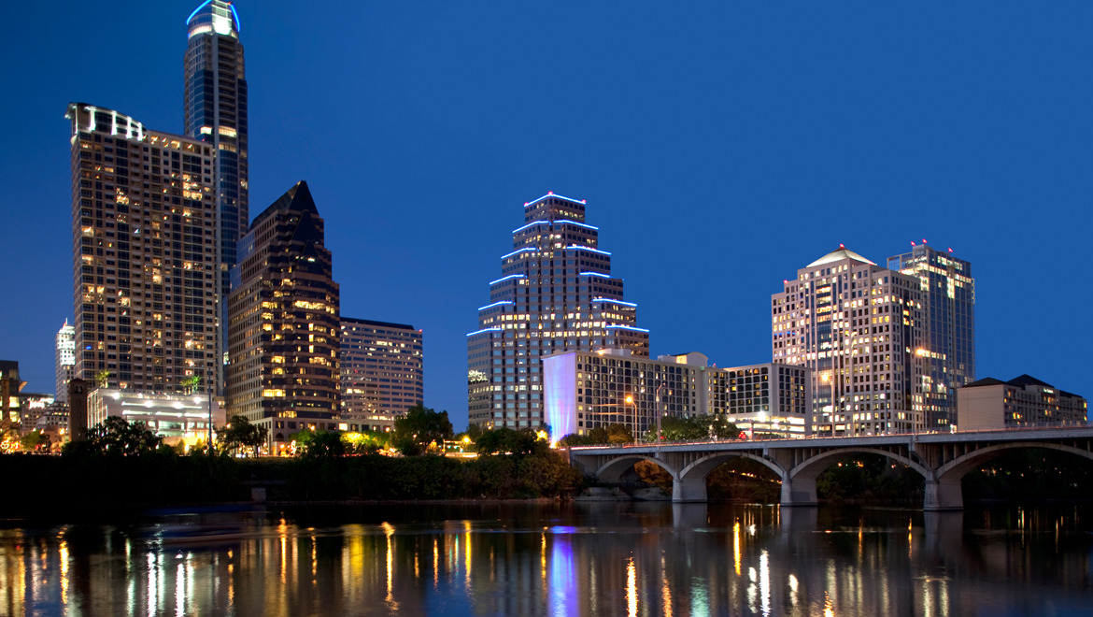
Zip 78701
Downtown, Rainey Street Historic District
The Texas State Capitol
Two Analyses pointed to 78701:
1. Most average rapes per zip code
2. Highest Crime rate by a factor of 5!

Slide 7
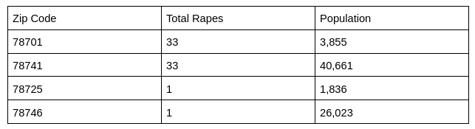
Highest Rape Rate
78701
- 0.00856 rapes per person
78741
- 0.0008115885 rapes per person
Our neffarious zip code has 10x more rapes per person than the next highest

Slide 8
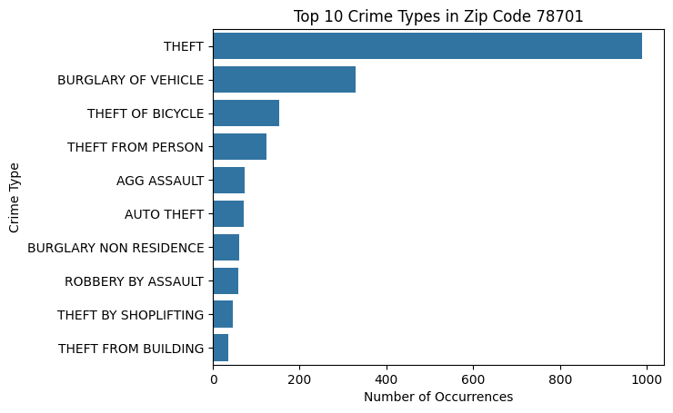
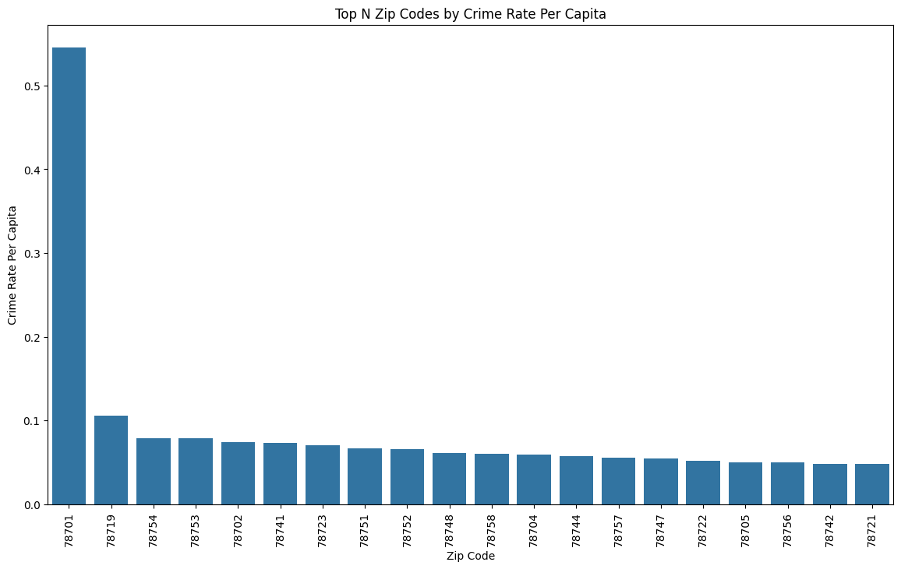
Crime per capita
Top 20 Zip Codes (Anomaly Detected)

Slide 9
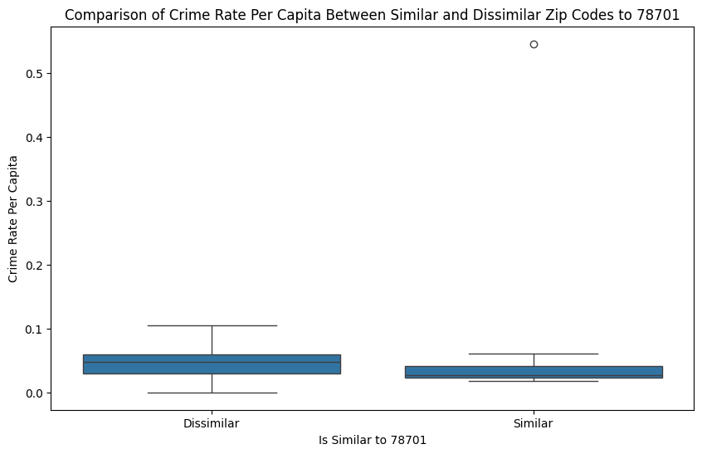
We created a similarity flag for other zip codes like 78701 based on median household income and people per square mile
Took the 25th percentile of zip codes and grouped them as similar to 78701

Slide 10
T-Tests resulted in a 1.574 Statistic and a 0.123 P-value
Failing to reject the null hypothesis.
And the results were inconclusive!

